Slide 1
Three-way Attention and Relational Knowledge for Commonsense Machine Comprehension
Liang Wang, Meng Sun, Wei Zhao, Kewei Shen, Jingming Liu
ACL 2018

Slide 2
Content
SemEval 2018 Task 11
ConceptNet
Model
Results
Conclusion

Slide 3
SemEval 2018 Task 11: Machine Comprehension using Commonsense Knowledge
In this task, systems will be presented with narrative texts about everyday activities and are required to answer multiple-choice questions based on this text.

Slide 4
SemEval 2018 Task 11: Machine Comprehension using Commonsense Knowledge
Example:
My backyard was looking a little empty, so I decided I would plant something. I went out and bought tree seeds. I found a spot in my yard that looked like it would get enough sunshine. There, I dug a hole for the seeds. Once that was done, I took my watering can and watered the seeds.
Why was the tree planted in that spot?
1. to get enough sunshine
2. there was no other space
B. What was used to dig the hole?
1. a shovel
2. their bare hands
C. Who took the watering can?
1. the grandmother
2. the gardener

Slide 5
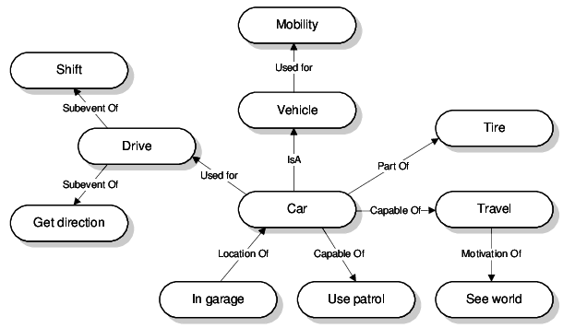
ConceptNet
ConceptNet is a freely-available semantic network, designed to help computers understand the meanings of words that people use. It is a directed graph with weight of each edge. Each node in the graph is a concept and each edge is one of 37 pre-defined relations.
21 million edges
8 million nodes

Slide 6
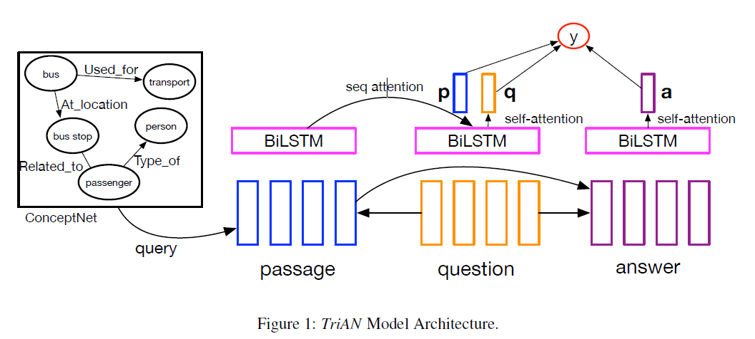
Model

Slide 7
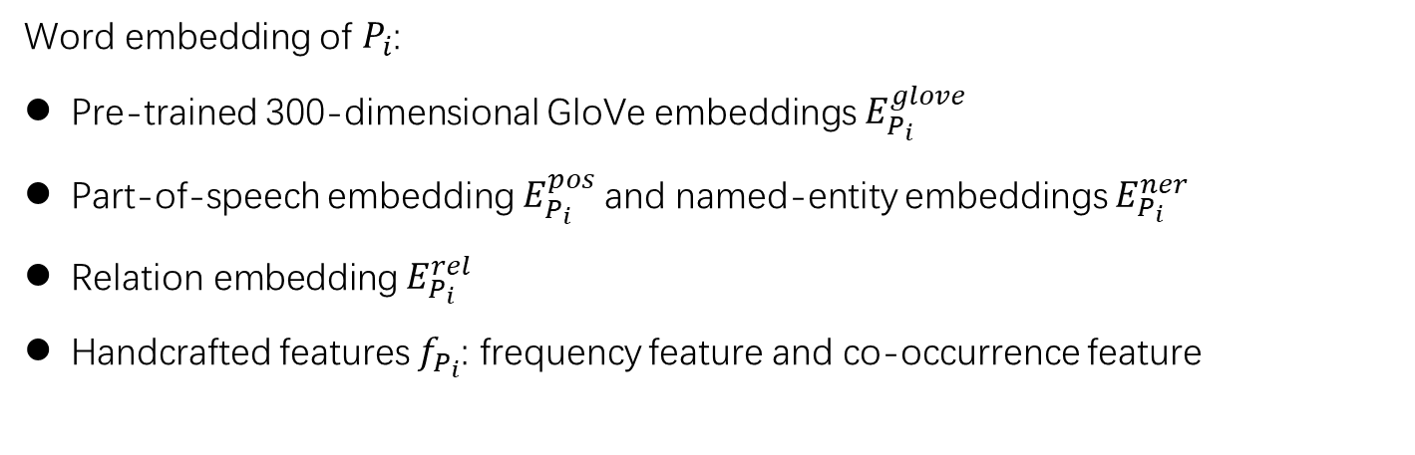
Model
Input Layer: passage ${\{P_{i}\}}_{i=1}^{|P|}$ , question ${\{Q_{i}\}}_{i=1}^{|Q|}$, answer ${\{A_{i}\}}_{i=1}^{|A|}$, label $y^{∗}∈\{0,1\}$
Word embedding of $P_{i}$:
Pre-trained 300-dimensional GloVe embeddings $E_{P_{i}}^{glove}$
Part-of-speech embedding $E_{P_{i}}^{pos}$and named-entity embeddings $E_{P_{i}}^{ner}$
Relation embedding $E_{P_{i}}^{rel}$
Handcrafted features $f_{P_{i}}$: frequency feature and co-occurrence feature
$$WP_{i}=[E_{P_{i}}^{glove};E_{P_{i}}^{pos};E_{P_{i}}^{ner};E_{P_{i}}^{rel};f_{P_{i}}]$$

Slide 8
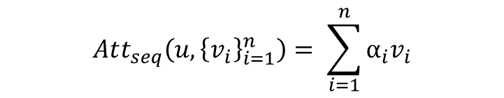
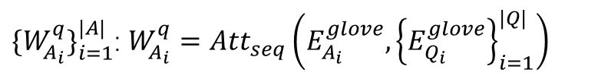
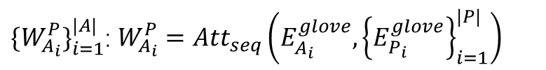
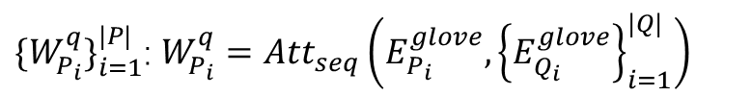
Model
Sequence attention:
$$Att_{seq}\left(u, {\left\{v_{i}\right\}}_{i=1}^{n}\right)= \sum_{i=1}^{n}{α_{i}v_{i}}$$
$$α_{i}=Softmax_{i}(f(W_{1}u)^{T}f(W_{1}v_{i}))$$
Sequence attention results:
$\{{W_{P_{i}}^{q}\}}_{i=1}^{|P|}$: $W_{P_{i}}^{q}=Att_{seq}\left(E_{P_{i}}^{glove}, {\left\{E_{Q_{i}}^{glove}\right\}}_{i=1}^{|Q|}\right)$
$\{{W_{A_{i}}^{P}\}}_{i=1}^{|A|}$: $W_{A_{i}}^{P}=Att_{seq}\left(E_{A_{i}}^{glove}, {\left\{E_{P_{i}}^{glove}\right\}}_{i=1}^{|P|}\right)$
$\{{W_{A_{i}}^{q}\}}_{i=1}^{|A|}$: $W_{A_{i}}^{q}=Att_{seq}\left(E_{A_{i}}^{glove}, {\left\{E_{Q_{i}}^{glove}\right\}}_{i=1}^{|Q|}\right)$

Slide 9
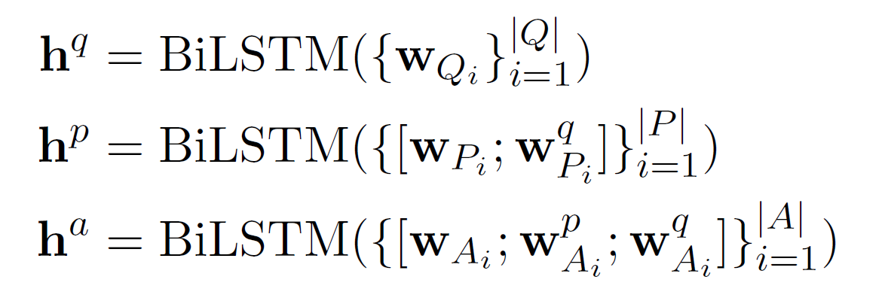
Model
BiLSTM:

Slide 10
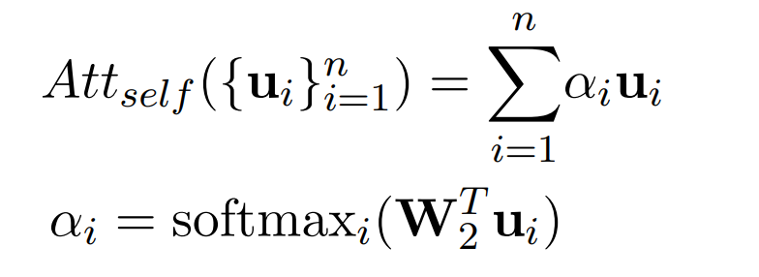
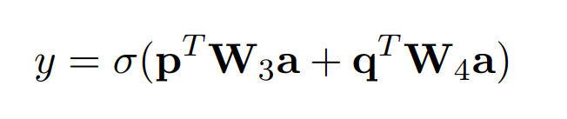



Model
Self-attention:
Output Layer:
$$q=Att_{self}\left({\left\{h_{i}^{q}\right\}}_{i=1}^{|Q|}\right)$$
$$a=Att_{self}\left({\left\{h_{i}^{a}\right\}}_{i=1}^{|A|}\right)$$
$$p=Att_{seq}\left(q, {\left\{h_{i}^{P}\right\}}_{i=1}^{|P|}\right)$$
Final output:

Slide 11
Model

Slide 12
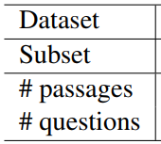
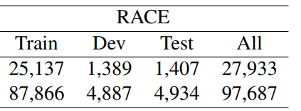
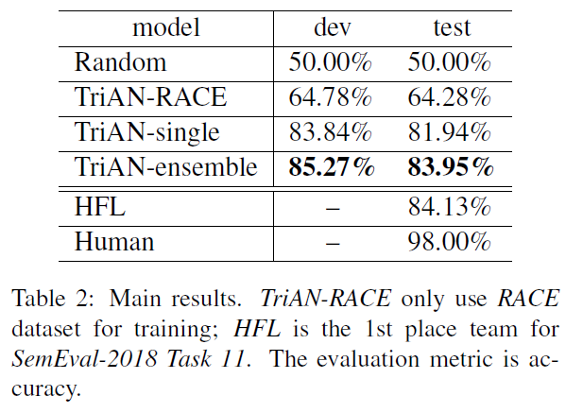
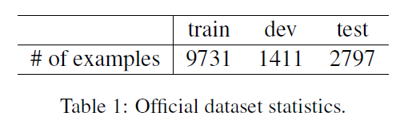
Results
This model is pretrained on RACE dataset. Then it is fine-tune on the official training data.

Slide 13
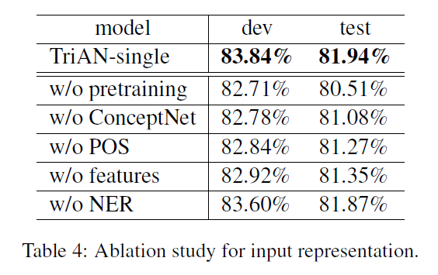
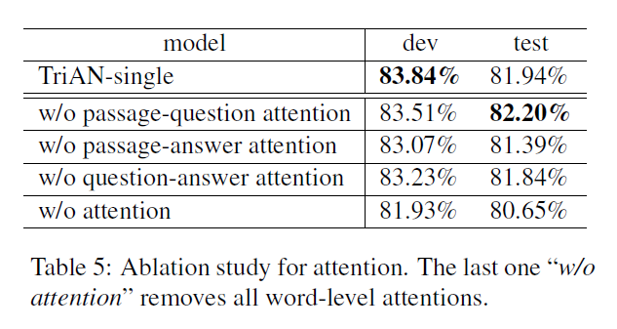
Results
Ablation study.

Slide 14
Conclusion
Pretraining can use more data and is proved helpful
Using external knowledge, like ConceptNet, can improve the model
Attention mechanism is helpful in such task.

Slide 15
Thanks

